Slide 1
Neural Networks
BY sean Soliman & Luis Rangel

Slide 2
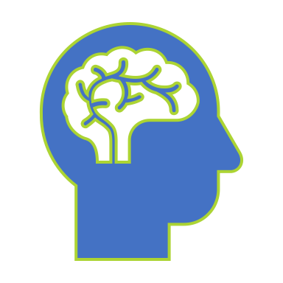
What is a Neural Network?

Slide 3
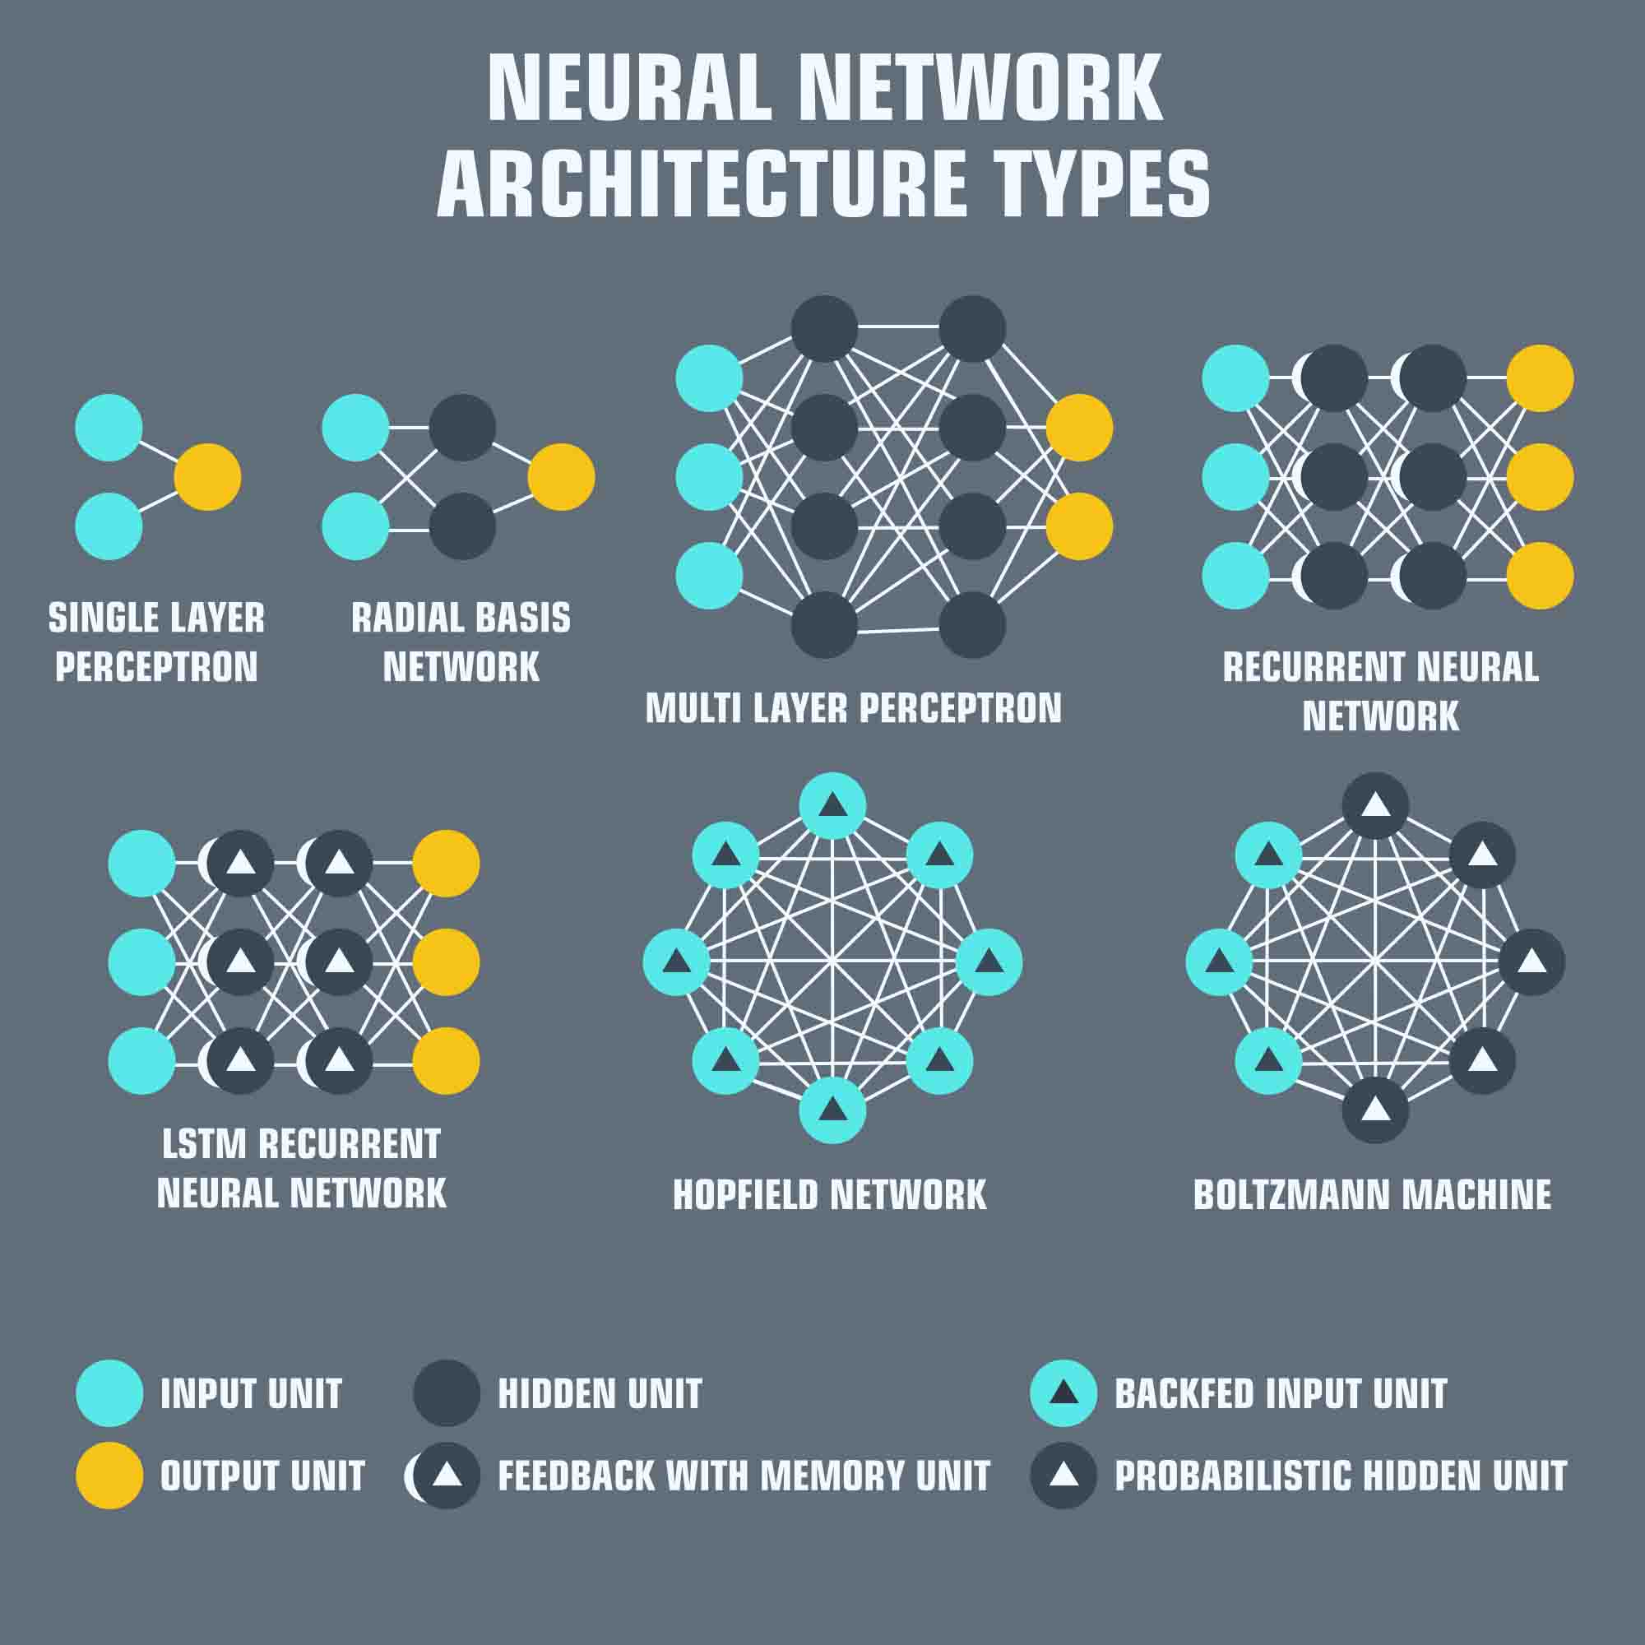
What is a Neural Network?
Neural Networks are sets of algorithms intended to recognize patterns and interpret data through clustering or labeling. Additionally, they also apply a training algorithm intended to assist the neural network with a continuous learning process.
Notes:
In essence, Neural Networks form the base of deep learning which in fact is a subset of Machine Learning.
Just by the sound of the name itself, you can easily tell that it is an algorithm inspired by how the human brain works (i.e. neurons and how they communicate and send signals to the rest of our bodies).
Obviously, it’s not as complex as a human brain per say and is also prone to errors. However, they do apply a training algorithm that helps them to continuously learn with the goal of providing much accurate predicted outputs.

Slide 4

Neural Network Architecture

Slide 5
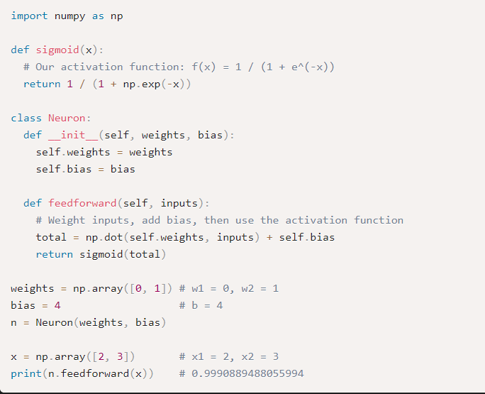
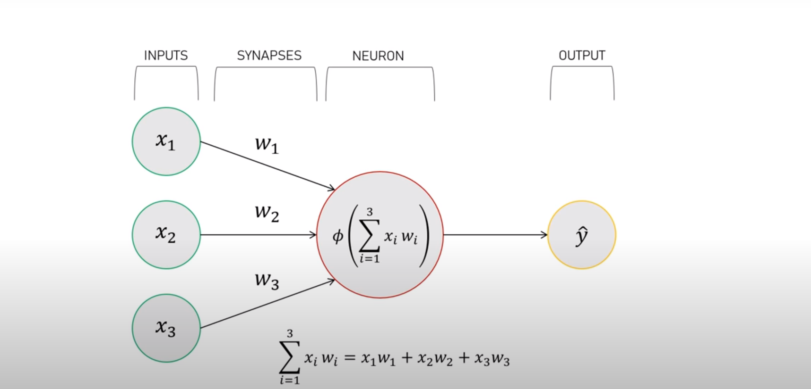
Neural Network Architecture
Notes:
Weights are the co-efficients of the equation which you are trying to resolve. Essentially, they reflect how important an input is. On the other hand, bias is simply a constant value (or a constant vector) that is added to the product of inputs and weights which in fact is used to offset the result. Think of it as a way to help a neuron to buy it’s way to go through. Not all neurons will be activated.

Slide 6

How it works?

Slide 7
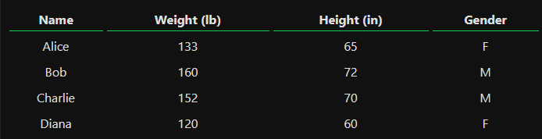
How it works?
Finding a person’s gender based on height and weight
Indicate the inputs to work with (Dataset)
Specify the outputs for the predictions
Notes:
Simple neural network example that will predict the gender of a person based on weight and height inputs given.

Slide 8
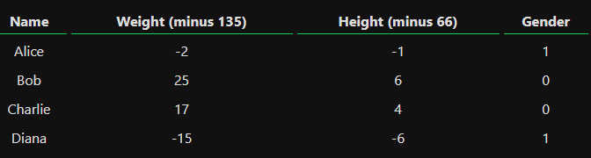
How it works?
Finding a person’s gender based on height and weight
Indicate the inputs to work with (Dataset)
Specify the outputs for the predictions
Notes:
Here the amounts where shifted to make the numbers look nicer. Normally, you’d shift by the mean.

Slide 9
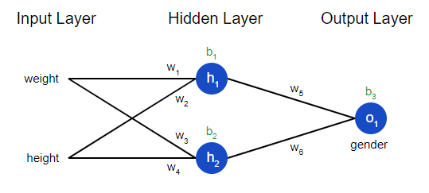
How it works?
Finding a person’s gender based on height and weight
Forward Propagation
Summation Formula
Sigmoid Function
Backward Propagation
Mean Squared Error (MSE)
Stochastic Gradient Descent (SGD)
Notes:
Linear algebra (vectors) and calculus (partial derivatives)

Slide 10
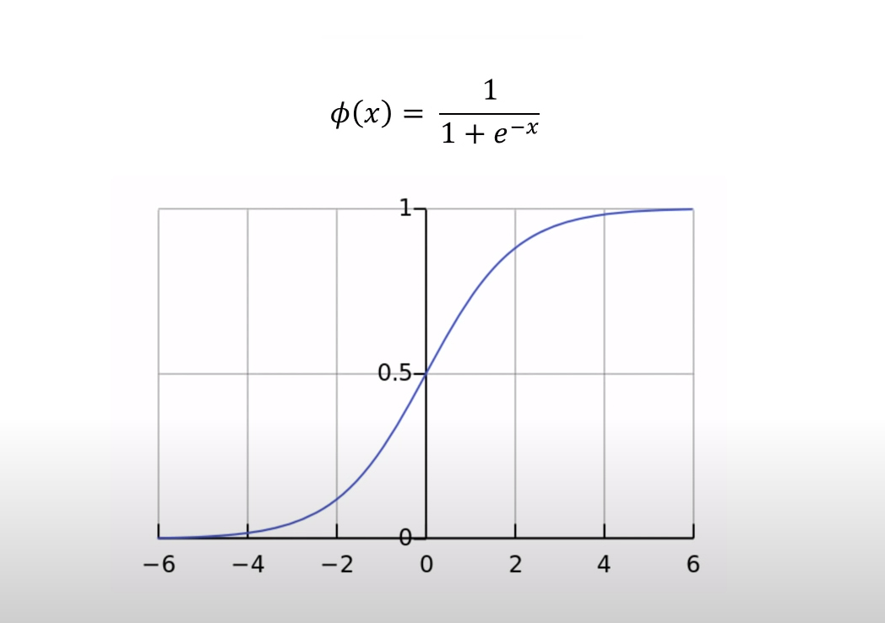
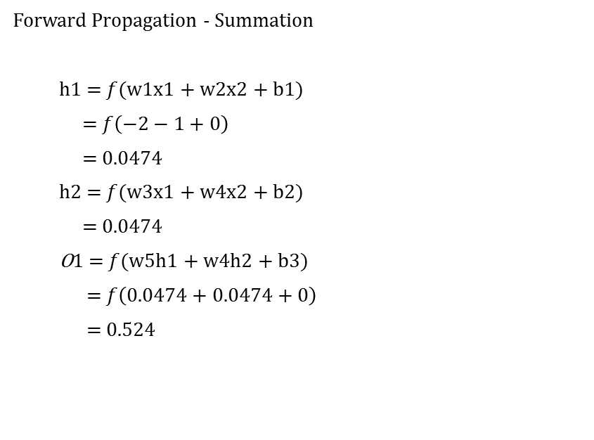
How it works?
Forward Propagation - Summation
h1 = $f$(w1x1 + w2x2 + b1)
= $f\left(−2−1+0\right)$
= $0.0474$
h2 = $f$(w3x1 + w4x2 + b2)
= $0.0474$
O1 = $f$(w5h1 + w4h2 + b3)
= $f\left(0.0474+0.0474+0\right)$
= 0.524
Notes:
Linear algebra (vectors) and calculus (partial derivatives). Used Alice’s height and weight for this example.

Slide 11
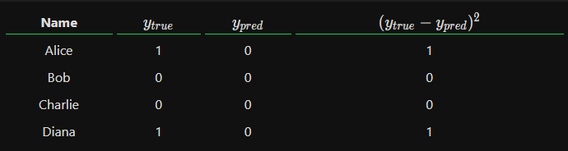
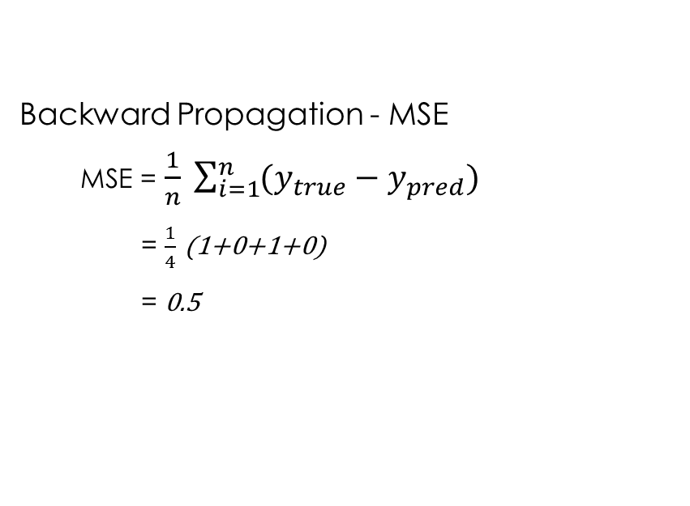
How it works?
Backward Propagation - MSE
MSE = $\frac{1}{n} \sum_{i=1}^{n}{(y_{true}−y_{pred})}$
= $\frac{1}{4}$ (1+0+1+0)
= 0.5

Slide 12
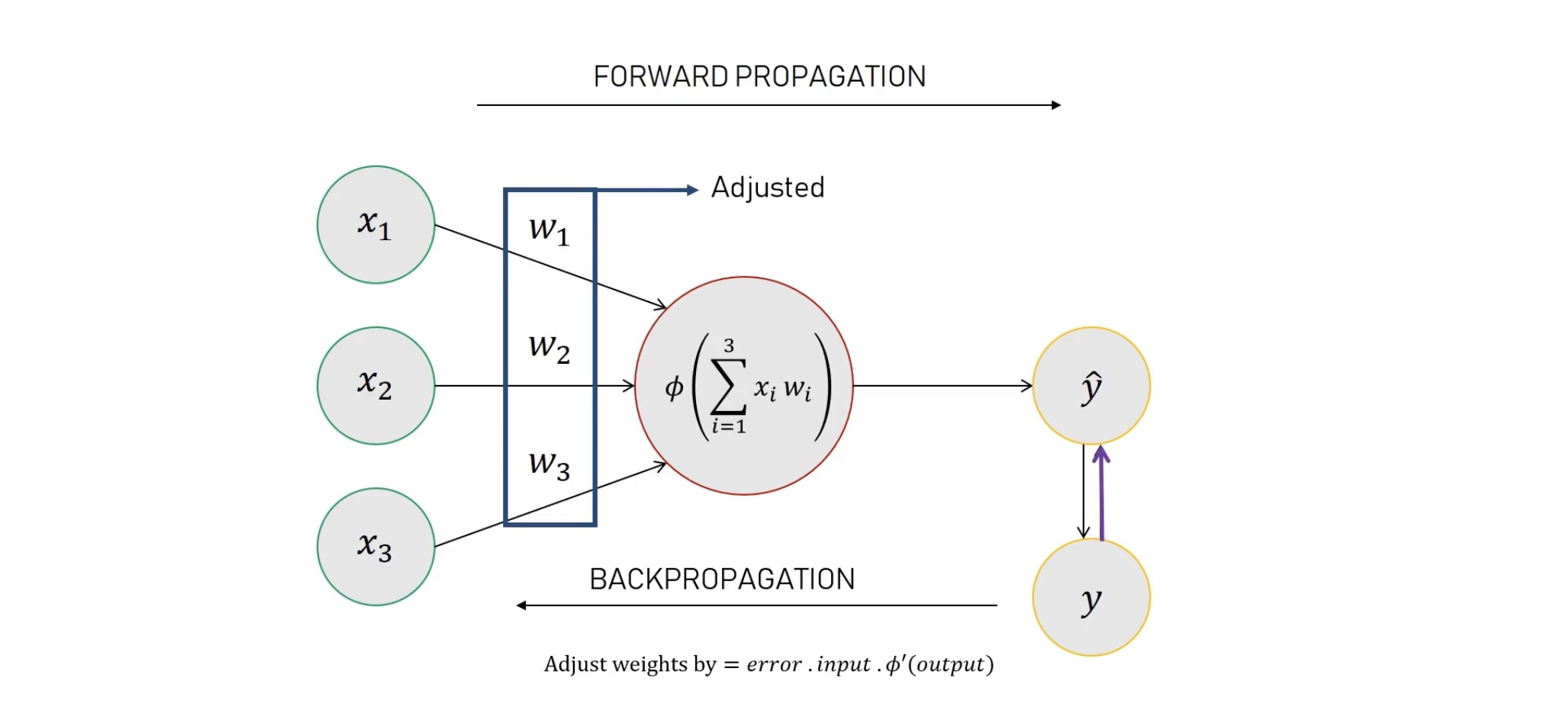
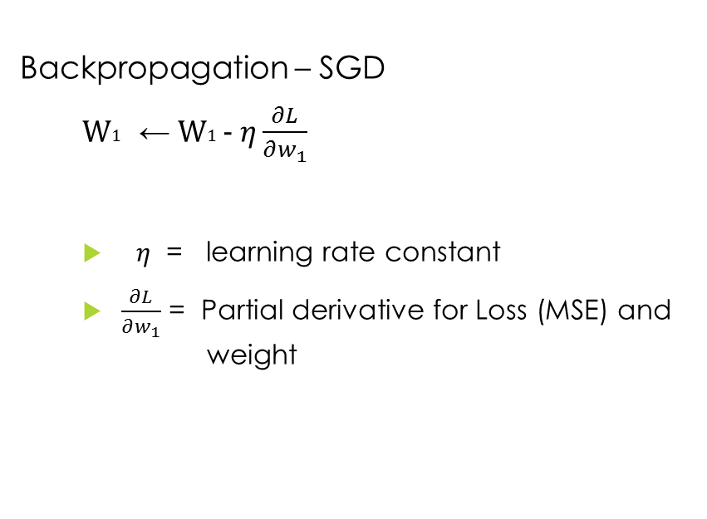
How it works?
Backpropagation – SGD
W1 ← W1 - $η\frac{∂L}{∂w_{1}}$
$η$ = learning rate constant
$\frac{∂L}{∂w_{1}}$ = Partial derivative for Loss (MSE) and weight

Slide 13
How it works?
Continuous Training
Neural Network will not always output accurate results every time
Program will still loop several times until MSE becomes low
Training takes time for it to become as optimal as possible

Slide 14

Where it can be applied?

Slide 15
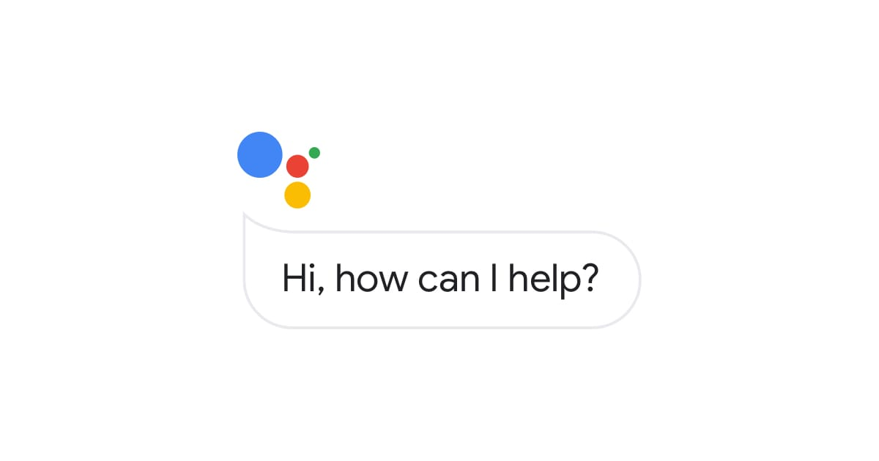
Where it can be applied
Language Translating
Music Composition
Video Games
Sales Forecasting
Facial Recognition
And many more…

Slide 16


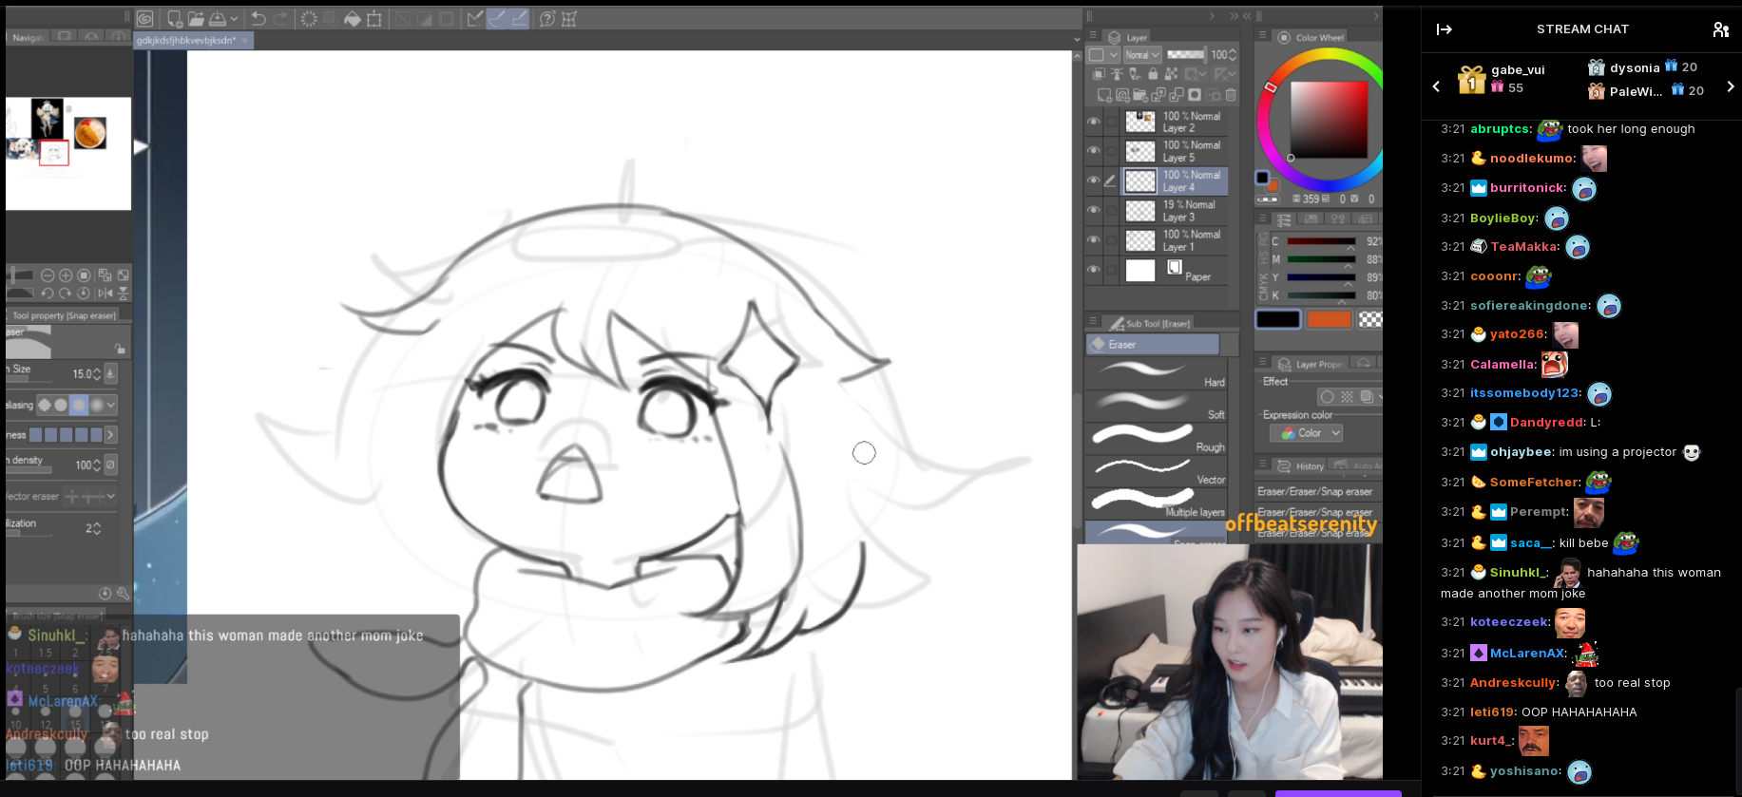
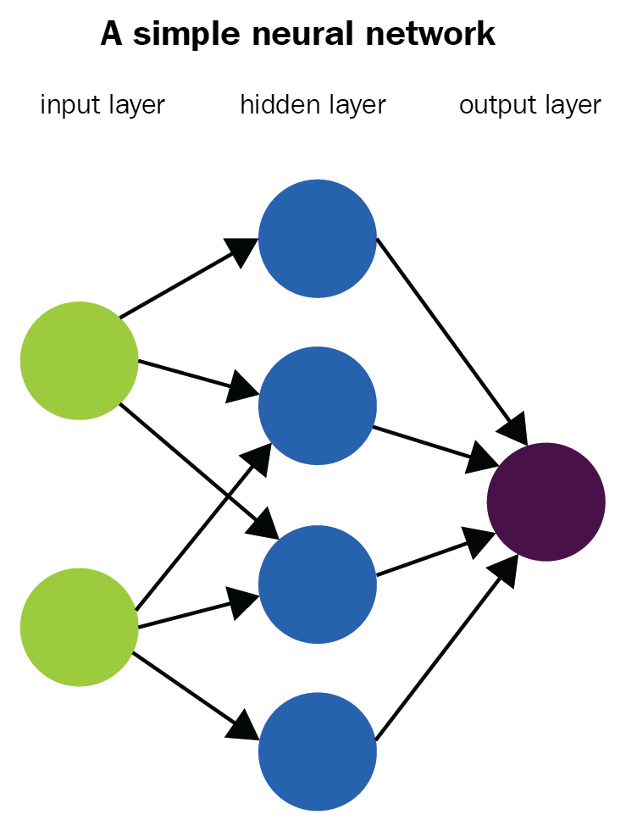
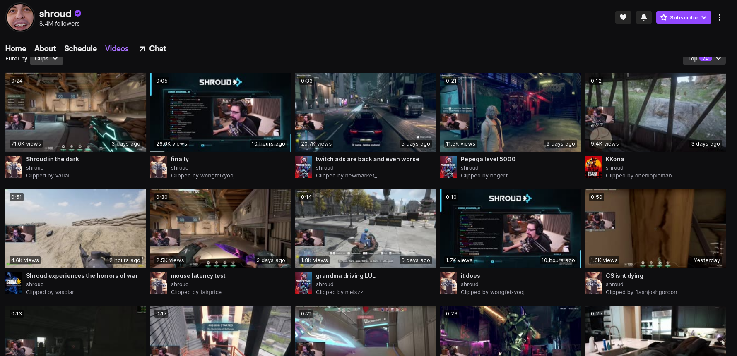
Predict Twitch clip category

Slide 17

Twitch
www.Twitch.tv is live streaming service for people (streamers/broadcasters) to broadcast/stream content with others(viewers) all over the world.
There are millions of daily active users
Ability to interact with one another
Main form of communication between the streamer and viewer is through Twitch’s chat system.

Slide 18
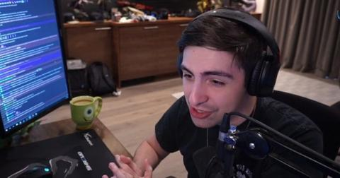
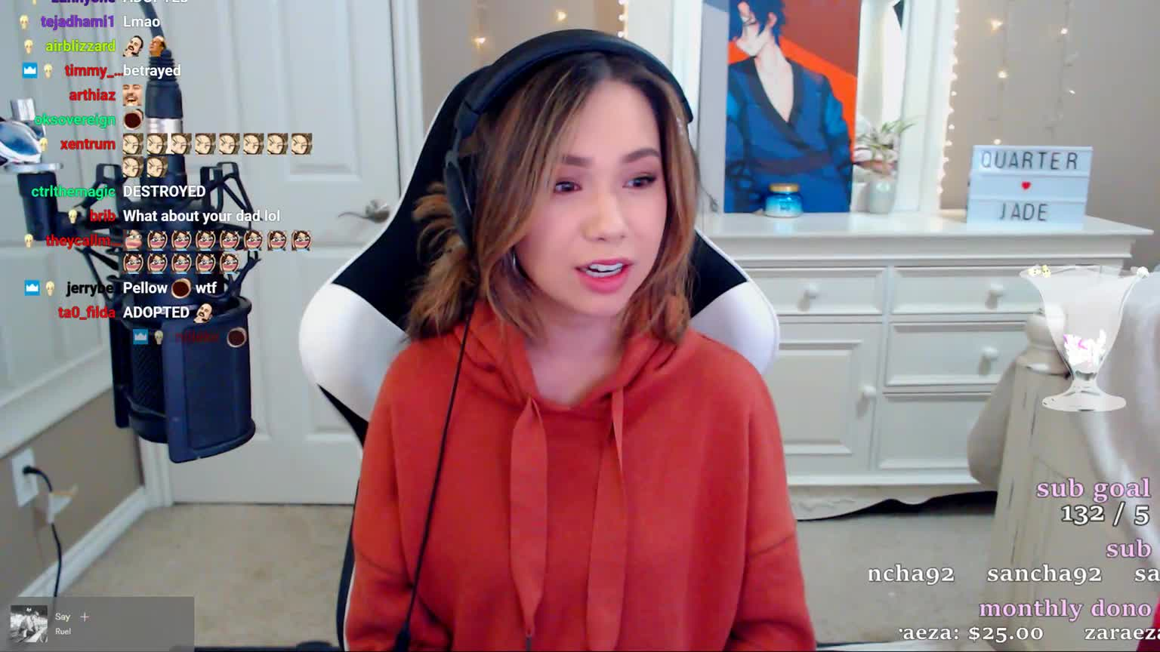
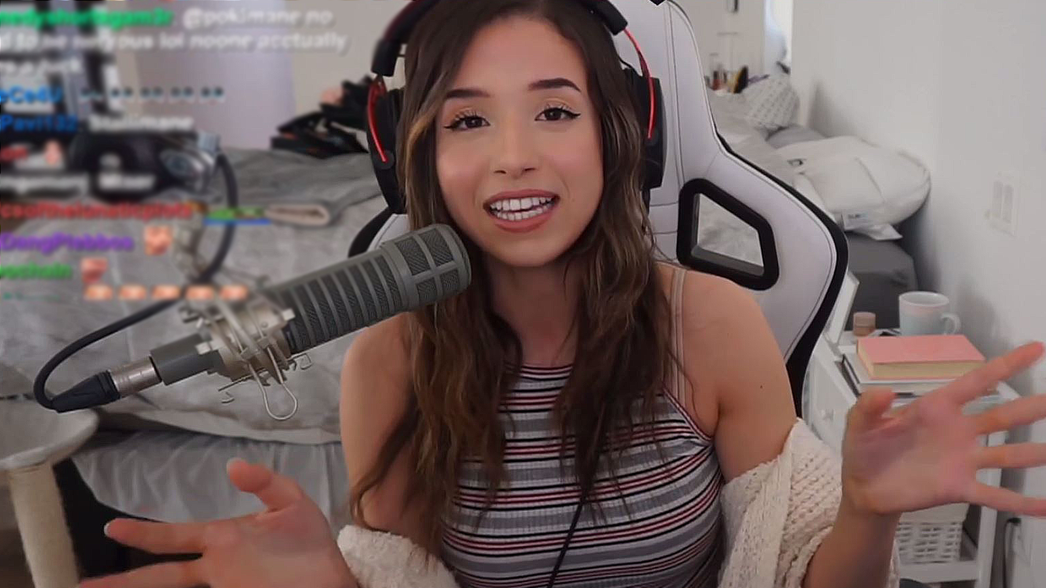
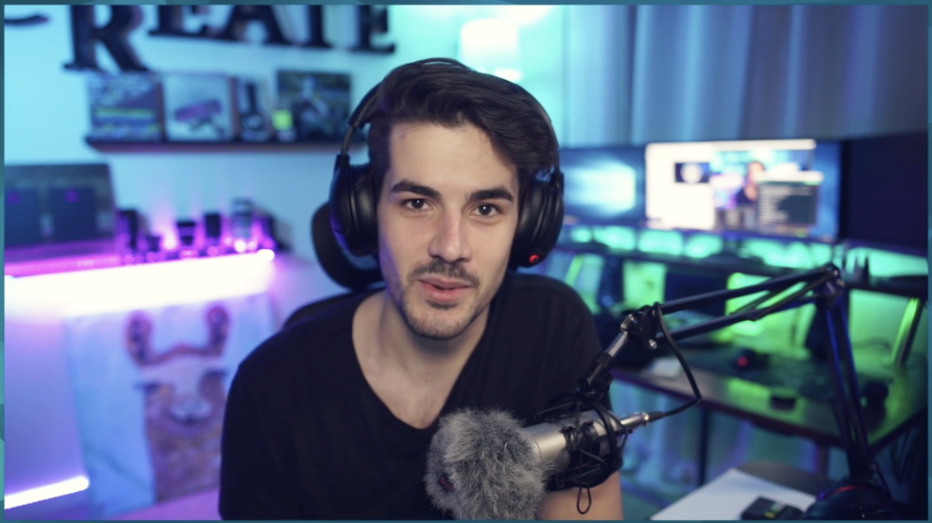
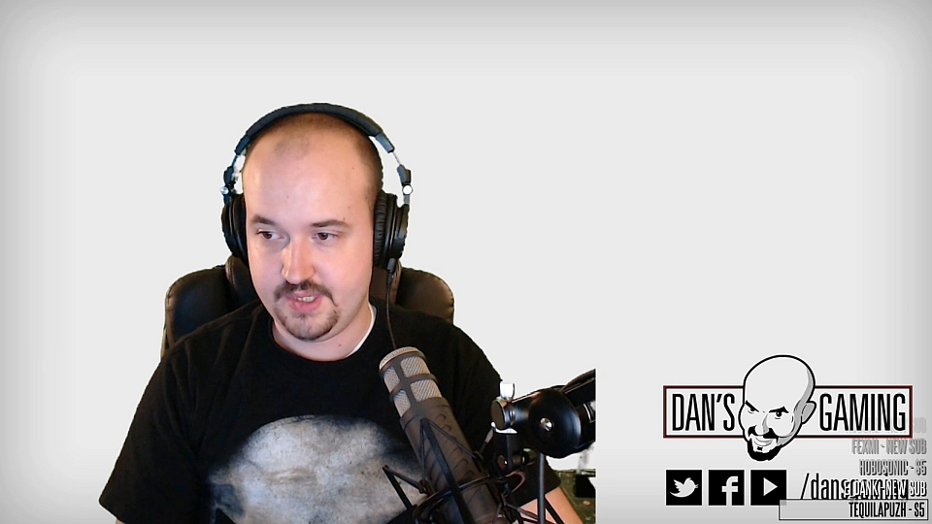
Streamers
Twitch revolves around its streamers
Streamer drives service
Twitch has become home to many streamers
Streamers build community/fans
Livelihood/job out of streaming
Streamers = content creators
Create and deliver content to viewers/community
Usually, take their Twitch content(videos) and create compilation videos of their highlights and clipped worthy content from their stream and upload to YouTube to further monetize their content.
So, Twitch clips = big importance

Slide 19
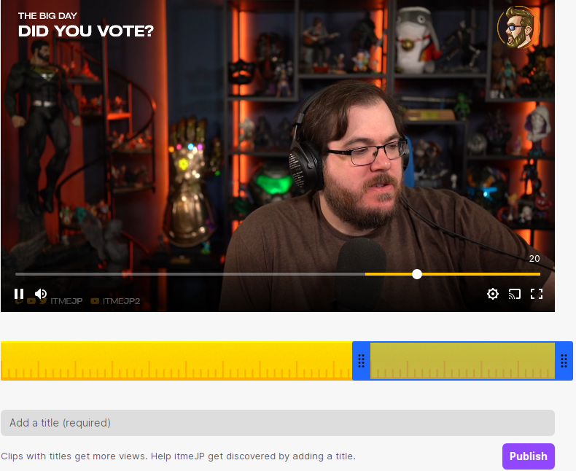
Twitch clips and their problem
Twitch has incorporated the ability for viewers to clip portions from a streamer’s stream(broadcast) along with viewer’s chat being recorded
However, there is no real way to determine a clip’s category outside of its title.
With millions of viewers and the ability for them to clip portions of a stream, this leads to tons of clips that potentially could have useful content for the streamers to use but are never seen by them due to the mass amount of clips that are made by viewers.
Clips would be of more use for both the viewer and streamer if they were able to be categorized

Slide 20
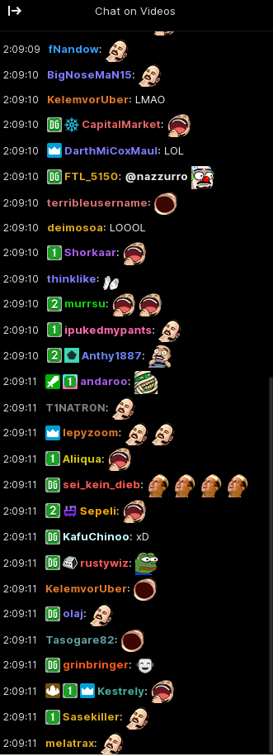
Neural Networks and Twitch Clips
+
With neural networks specializing in training and producing a prediction we can utilize a Twitch clip’s recorded chat to determine a category for the clip.
INPUT LAYER: Twitch clip chat log
HIDDEN LAYER: Keywords detected
Funny: “funny, hilarious, lol, lul, haha,, omegalul” etc.
Amazing/Epic: “Amazing, epic, wow, cool, pogchamp, pog, poggers, ez”
Sad: “sad, aww, :(, noo, biblethump, FeelsBadMan
OUTPUT LAYER: “This video is likely to be x”

Slide 21
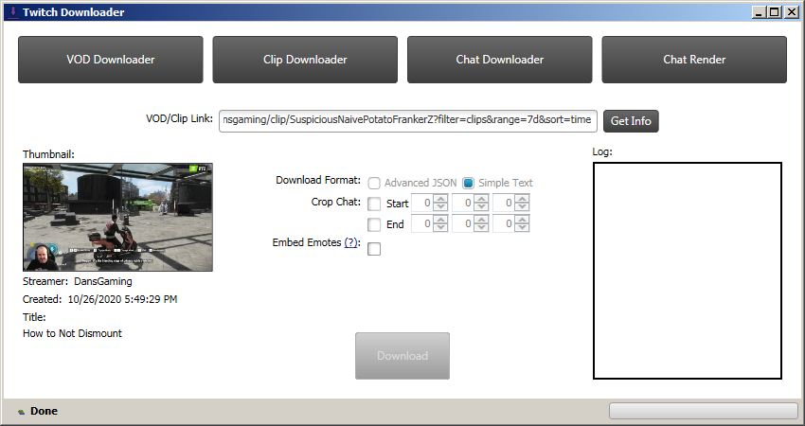
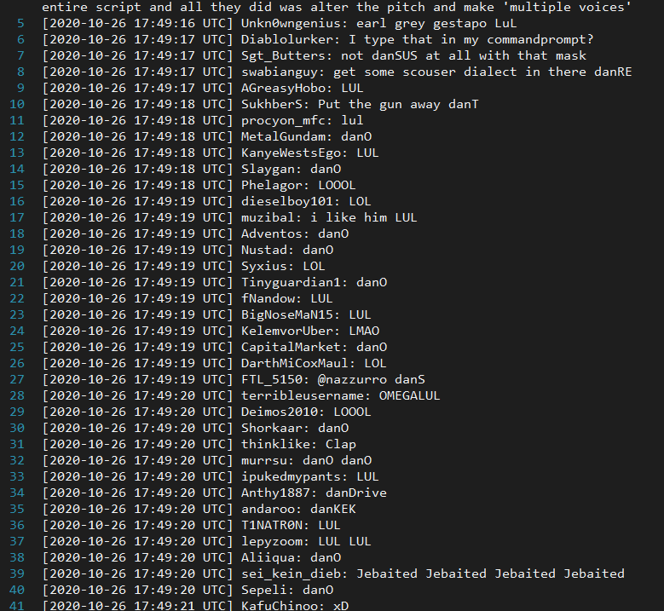
Dataset
Considering our application- our dataset would be coming from chat logs from clipped twitch videos.
We’ve obtained our sample data set by using the program “TwitchDownloader” along with selected popular clipped videos from Twitch.
TwitchDownloader: https://github.com/lay295/TwitchDownloader
There are, however, many other ways to obtain the chat log from a clipped twitch video.
Characteristics of our dataset include the viewer’s username, and timestamped message.
We however only make use of their message/response.

Slide 22
Tools
TwitchDownloader
Used to grab clip log
TwitchDownloader: https://github.com/lay295/TwitchDownloader
Python packages
Numpy: https://numpy.org/
Keras: https://keras.io/
Scikit: https://scikit-learn.org/stable/
Tensorflow: https://www.tensorflow.org/
Premade Neural Network samples
https://github.com/jonasbostoen/simple-neural-network
https://github.com/jg-fisher/diabetesNeuralNetwork

Slide 23
Results
No typical/conventional “dataset” that we could find for our application since our approach is new, so we picked 30 random twitch clip chat logs from different users to run on a neural network.
Neural network model to reduce errors through training(back propagation)
The more training -> lesser the errors

Slide 24
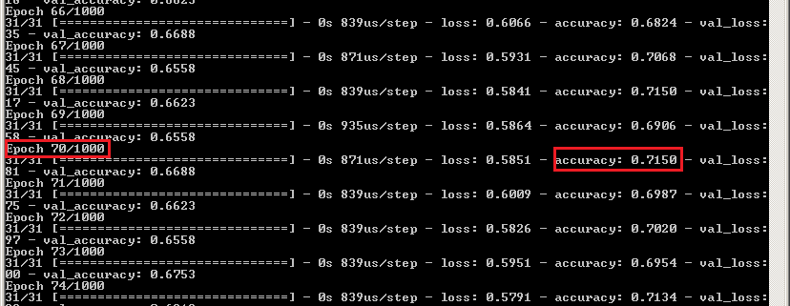
Results

Slide 25
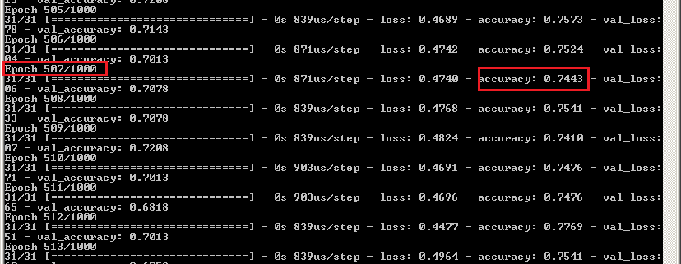
Results

Slide 26
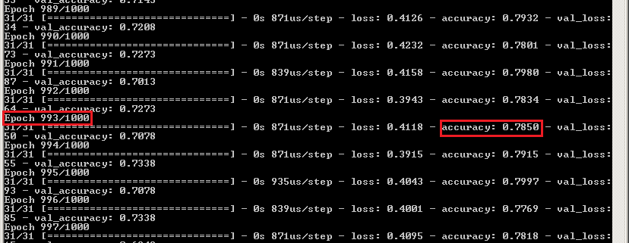
Results

Slide 27
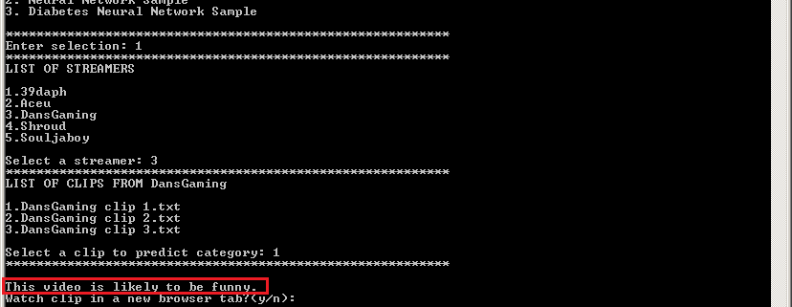
Results

Slide 28
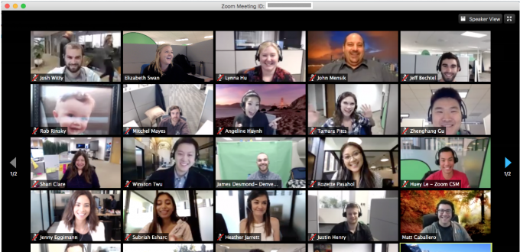
Contribution
A potential contribution would be towards implementation on remote learning. With a majority of schools/classes being taught online the use of neural networks could benefit.
In this scenario, neural networks can be used as a tool for prediction in multiple ways such as:
Highlighting important topics that are covered during instructional learning and meetings.

Slide 29

Comparisons and conclusions
Many types of Neural Networks available
Each Pros and cons

Slide 30
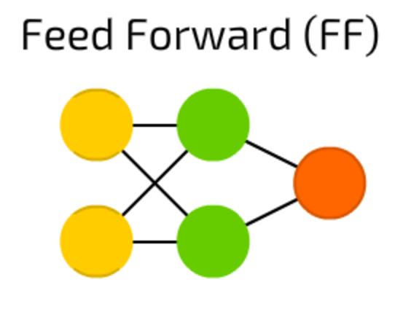
Feed Forward (FF) Neural Network
All nodes are fully connected
Activation flows from input layer to output, without back loops
There is one layer between input and output (hidden layer)

Slide 31
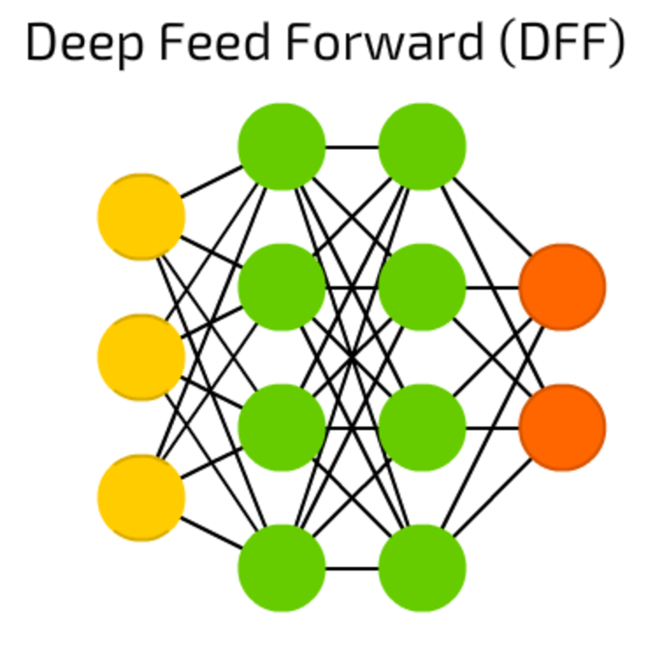
Deep Feed Forward (DFF) Neural Network
Stacking/more layers
Exponential growth in training times

Slide 32
Reference List
Livshin, I. (2019). Artificial Neural Networks with Java. In Artificial Neural Networks with Java (1st ed.). Apress L. P. https://doi.org/10.1007/978-1-4842-4421-0
B. R. Amrutha and K. R. Bindu, "Detecting Hate Speech in Tweets Using Different Deep Neural Network Architectures," 2019 International Conference on Intelligent Computing and Control Systems (ICCS), Madurai, India, 2019, pp. 923-926, doi: 10.1109/ICCS45141.2019.9065763.
J. Kim, K. Park, H. Song, J. Y. Park and M. Cha, "Learning How Spectator Reactions Affect Popularity on Twitch," 2020 IEEE International Conference on Big Data and Smart Computing (BigComp), Busan, Korea (South), 2020, pp. 147-154, doi: 10.1109/BigComp48618.2020.00-84.
X. Ma, C. Zhang, J. Liu, R. Shea and D. Fu, "Live Broadcast With Community Interactions: Bottlenecks and Optimizations," in IEEE Transactions on Multimedia, vol. 19, no. 6, pp. 1184-1194, June 2017, doi: 10.1109/TMM.2016.2646182.
E. Vonk, L. C. Jain and L. P. J. Veelenturf, "Neural network applications," Proceedings Electronic Technology Directions to the Year 2000, Adelaide, SA, Australia, 1995, pp. 63-67, doi: 10.1109/ETD.1995.403490.
S. Albawi, T. A. Mohammed and S. Al-Zawi, "Understanding of a convolutional neural network," 2017 International Conference on Engineering and Technology (ICET), Antalya, 2017, pp. 1-6, doi: 10.1109/ICEngTechnol.2017.8308186.
C. Zhang and W. Xu, "Neural networks: Efficient implementations and applications," 2017 IEEE 12th International Conference on ASIC (ASICON), Guiyang, 2017, pp. 1029-1032, doi: 10.1109/ASICON.2017.8252654.
R. E. Uhrig, "Introduction to artificial neural networks," Proceedings of IECON '95 - 21st Annual Conference on IEEE Industrial Electronics, Orlando, FL, USA, 1995, pp. 33-37 vol.1, doi: 10.1109/IECON.1995.483329.
M. Mishra and M. Srivastava, "A view of Artificial Neural Network," 2014 International Conference on Advances in Engineering & Technology Research (ICAETR - 2014), Unnao, 2014, pp. 1-3, doi: 10.1109/ICAETR.2014.7012785.
G. P. Zhang, "Neural networks for classification: a survey," in IEEE Transactions on Systems, Man, and Cybernetics, Part C (Applications and Reviews), vol. 30, no. 4, pp. 451-462, Nov. 2000, doi: 10.1109/5326.897072.

